Slide 1
PatternHunter: A Fast and Highly Sensitive Homology Search Method

Slide 2
Homology Search
Homology search consumes 10% of the world’s supercomputing time
NCBI Blast server processes 10⁵ queries/day
GenBank doubles in size every 18 months
Completed genomes: human, mouse, rice, fly, etc
Software must be scalable for large datasets

Slide 3
Homology Search Tools
Identify short seed matches (consecutive k bases) between DNA sequences which are then extended
  BLAST, FASTA too slow and miss many alignment
Smith-Waterman DP too slow
MegaBlast high speed, works well for highly similar sequences

Slide 4
Discontiguous Seeds
Requires matching pairs of bases at a subset of positions
Califano and Rigoutsos (1993)
  Random discontiguous pattern in FLASH
Buhler (2001)
  Sensitivity of random patterns in LSH-ALL-PAIRS comparison algorithm
Blastz underlying PipMaker program (2000)
PatternHunter (Ma, Tromp, and Li, 2002)

Slide 5
A homology between mouse and human genomes
GCNTACACGTCACCATCTGTGCCACCACNCATGTCTCTAGTGATCCCTCATAAGTTCCAACAAAGTTTGC
|| ||||| | ||| |||| || |||||||||||||||||| | |||||||| | | |||||
GCCTACACACCGCCAGTTGTG-TTCCTGCTATGTCTCTAGTGATCCCTGAAAAGTTCCAGCGTATTTTGC
GAGTACTCAACACCAACATTGATGGGCAATGGAAAATAGCCTTCGCCATCACACCATTAAGGGTGA----
|| ||||||||| |||||| | ||||| |||||||| ||| |||||||| | | | ||
GAATACTCAACAGCAACATCAACGGGCAGCAGAAAATAGGCTTTGCCATCACTGCCATTAAGGATGTGGG
------------------TGTTGAGGAAAGCAGACATTGACCTCACCGAGAGGGCAGGCGAGCTCAGGTA
||||||||||||| ||| ||||||||||| || ||||||| || |||| |
TTGACAGTACACTCATAGTGTTGAGGAAAGCTGACGTTGACCTCACCAAGTGGGCAGGAGAACTCACTGA
GGATGAGGTGGAGCATATGATCACCATCATACAGAACTCAC-------CAAGATTCCAGACTGGTTCTTG
||||||| |||| | | |||| ||||| || ||||| || |||||| |||||||||||||||
GGATGAGATGGAACGTGTGATGACCATTATGCAGAATCCATGCCAGTACAAGATCCCAGACTGGTTCTTG
Smith-Waterman is the most accurate method.
Time complexity：O(mn).

Slide 6
BLAST finds a “hit” and then extends
GCNTACACGTCACCATCTGTGCCACCACNCATGTCTCTAGTGATCCCTCATAAGTTCCAACAAAGTTTGC
|| ||||| | ||| |||| || |||||||||||||||||| | |||||||| | | |||||
GCCTACACACCGCCAGTTGTG-TTCCTGCTATGTCTCTAGTGATCCCTGAAAAGTTCCAGCGTATTTTGC
GAGTACTCAACACCAACATTGATGGGCAATGGAAAATAGCCTTCGCCATCACACCATTAAGGGTGA----
|| ||||||||| |||||| | ||||| |||||||| ||| |||||||| | | | ||
GAATACTCAACAGCAACATCAACGGGCAGCAGAAAATAGGCTTTGCCATCACTGCCATTAAGGATGTGGG
------------------TGTTGAGGAAAGCAGACATTGACCTCACCGAGAGGGCAGGCGAGCTCAGGTA
||||||||||||| ||| ||||||||||| || ||||||| || |||| |
TTGACAGTACACTCATAGTGTTGAGGAAAGCTGACGTTGACCTCACCAAGTGGGCAGGAGAACTCACTGA
GGATGAGGTGGAGCATATGATCACCATCATACAGAACTCAC-------CAAGATTCCAGACTGGTTCTTG
||||||| |||| | | |||| ||||| || ||||| || |||||| |||||||||||||||
GGATGAGATGGAACGTGTGATGACCATTATGCAGAATCCATGCCAGTACAAGATCCCAGACTGGTTCTTG
Seed match = hit

Slide 7
Example of missing a target
Fail:
GAGTACTCAACACCAACATTAGTGGGCAATGGAAAAT
|| ||||||||| |||||| | |||||| ||||||
GAATACTCAACAGCAACATCAATGGGCAGCAGAAAAT
Dilemma
  Sensitivity – needs shorter seeds
    the success rate of finding a homology
  Speed – needs longer seeds
    Mega-BLAST uses seeds of length 28.

Slide 8
PatternHunter uses “spaced seeds”
111010010100110111 (called a model)
  Eleven required matches (weight=11)
  Seven “don’t care” positions
GAGTACTCAACACCAACATTAGTGGCAATGGAAAAT…
|| ||||||||| ||||| || ||||| ||||||
GAATACTCAACAGCAACACTAATGGCAGCAGAAAAT…
111010010100110111
Hit = all the required matches are satisfied.
BLAST seed model = 11111111111

Slide 9
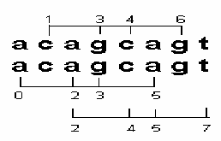
Selecting Good Seeds
INDEPENDENCE: probabilities of matches at different offsets are not independent
Generally, fewer bases shared between seed and shifted copies, higher sensitivity
Consecutive models → low sensitivity

Slide 10
PatternHunter
Optimal model via DP :
111010010100110111
w = 11, s = 18
shifted copy shares 5 bases

Slide 11
PatternHunter
Optimal model via DP :
111010010100110111
111010010100110111
w = 11, s = 18
shifted copy shares 5 bases

Slide 12
Observations re. spaced seeds
Seed models with different shapes can detect different homologies.
Two consequences:
  Some models may detect more homologies than others
    More sensitive homology search
    PatternHunter I
  Can use several seed models simultaneously to hit more homologies
    Approaching 100% sensitive homology search
    PatternHunter II

Slide 13
Weight of a seed
Lemma: The expected number of hits of a weight W length M seed model within a length L region with similarity p is (L-M+1)p^{W}
Proof: There are (L-M+1) positions a hit can occur. At each position, p^{W} hit is expected. Q.E.D.
Seed models with the same weight generate approximately the same amount of hits.
  Speed is approximately the same.
  Sensitivity is not necessarily the same.
    num of hits v.s. num of regions that contain hits.
GAGTACTCAACACCAACATTAGTGGCAATGGAAAAT
|| ||||||||| ||||| || ||||| ||||||
GAATACTCAACAGCAACACTAATGGCAGCAGAAAAT
111010010100110111

Slide 14
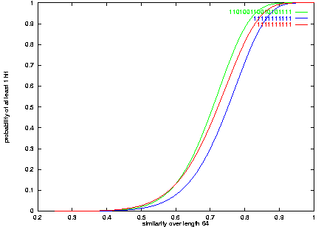
Simulated sensitivity curves

Slide 15
Why spaced seeds are better?
TTGACCTCACC?
|||||||||||?
TTGACCTCACC?
11111111111
11111111111
CAA?A??A?C??TA?TGG?
|||?|??|?|??||?|||?
CAA?A??A?C??TA?TGG?
111010010100110111
111010010100110111
BLAST’s seed usually uses more than one hits to detect one homology (redundant)
Spaced seeds uses fewer hits to detect one homology (efficient)

Slide 16
PH’s seed does not overlap heavily
PH’s seed do not overlap heavily when shifts:
111010010100110111
111010010100110111
111010010100110111
111010010100110111
111010010100110111
111010010100110111
111010010100110111
......
The hits at different positions are independent.
The probability of having the second hit is 5*p⁶ + …
  compare to BLAST’s model p + p² + p³ + p⁴ + …

Slide 17
PatternHunter I performance
Blastn MB28 PH
E.coli (4.7M) v.s. H.inf (1.8M)
  716s /158M 5s/561M 34s/78M
Arabidopsis chr2 (19.6M) v.s. chr4 (17.5M)
  -- 21720s/1087M 5020s/279M
Human chr21 (26.2M) v.s. chr22 (35M)
  -- -- 14512s/419M
  All used a 700MHZ PentiumIII PC with 1G byte memory.
Human (3G) v.s. Mouse (3G)*
  Using 2-hit, weight 12 seed, PH used 6 days with a 1GHZ PentiumIII PC with 2G byte memory.
  With Blast, it would otherwise take months with parallel computers to finish.

Slide 18
Multiple Seeds – PatternHunter II:

Slide 19
PatternHunter II: Optimized Multiple seeds
  Basic Searching Algorithm
  Select a group of spaced seed models
  For each hit of each model, conduct extension to find a homology.
  Selecting optimal multiple seed is NP-hard.

Slide 20
The seeds obtained under a simple homology distribution
(homology identity = 0.7, homology length=64)
111011001011010111,
1111000100010011010111,
1100110100101000110111,
1110100011110010001101,
……
……

Slide 21
Experiments on real data
About 30k mouse ESTs (25Mb) and 4k human ESTs (3Mb)
  downloaded from NCBI genbank.
  “low complexity” regions were filtered out.
SSearch (Smith-Waterman method) finds “all” pairs of ESTs with significant local alignments.
Check how many percents of those pairs can be “found” by BLAST and different configurations of PatternHunter.

Slide 22
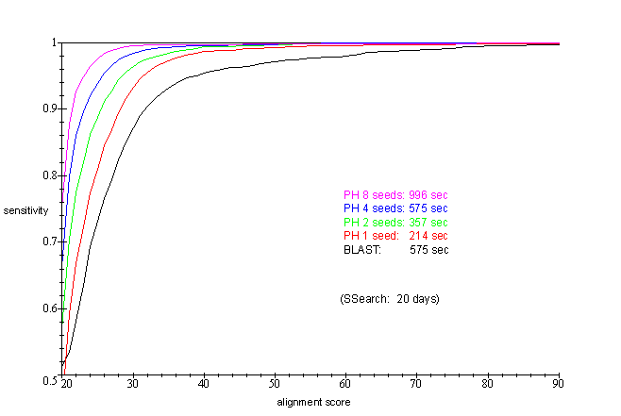
Sensitivity curves:

